Slide 1


Ways to create a Stream
1.From a Collection via the stream() and parallelStream() methods.
2.From an array via Arrays.stream(Object[]):

Slide 2
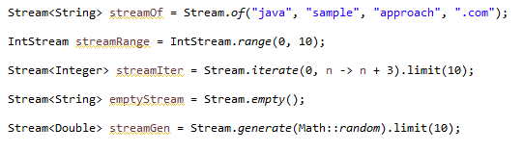
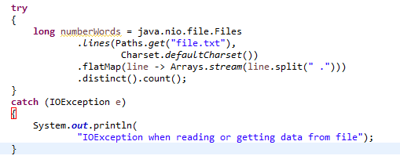
Ways to create a Stream
3.From static factory methods on the stream classes: Stream.of(Object[]), IntStream.range(int, int), Stream.iterate(Object, UnaryOperator)…
4.From methods in java.nio.file.Files:

Slide 3
Ways to create a Stream
5.From methods in the JDK:

